Slide 1
Fast Transient DC-DC Converter
PICO Project Presentation
Team : Pakistan 04

Slide 2
TEAM MEMBERS
Muhammad Jawad Shakil (MS Fellow at FAST NU ISB)
Zohaib Ahmed (MS Fellow at FAST NU ISB)
Sonia Kiran (MS Fellow at FAST NU ISB)

Slide 3
OUTLINE
Motivation
Background
Working Principle
Building Blocks of DC-DC Converter
Problem Statement
Detailed Design
Simulation Results

Slide 4
Motivation
Multiple SoC modules require analog and mixed signal circuitry for minimal power loss[1].
Global power supply should be split into local supplies.
In a chip, diff. modules requires diff. power supply for optimal operation.
Hence we need On-Chip DC-DC Converter.
Transient Response of Converter should be stable under load variation.
1. Electrical and thermal characterization of an inductor-based ANPC-type buck converter in 14 nm CMOS technology for microprocessor applications. IEEE Open Journal of Power Electronics,2020.

Slide 5
Background
There are two architecture for DC-DC Converters
Inductor based (IB) DC-DC Converter i.e. uses inductor as a main component for energy storing device.
Switch Capacitor (SC) based DC-DC Converter i.e. uses capacitor as a main component for energy storing device.

Slide 6
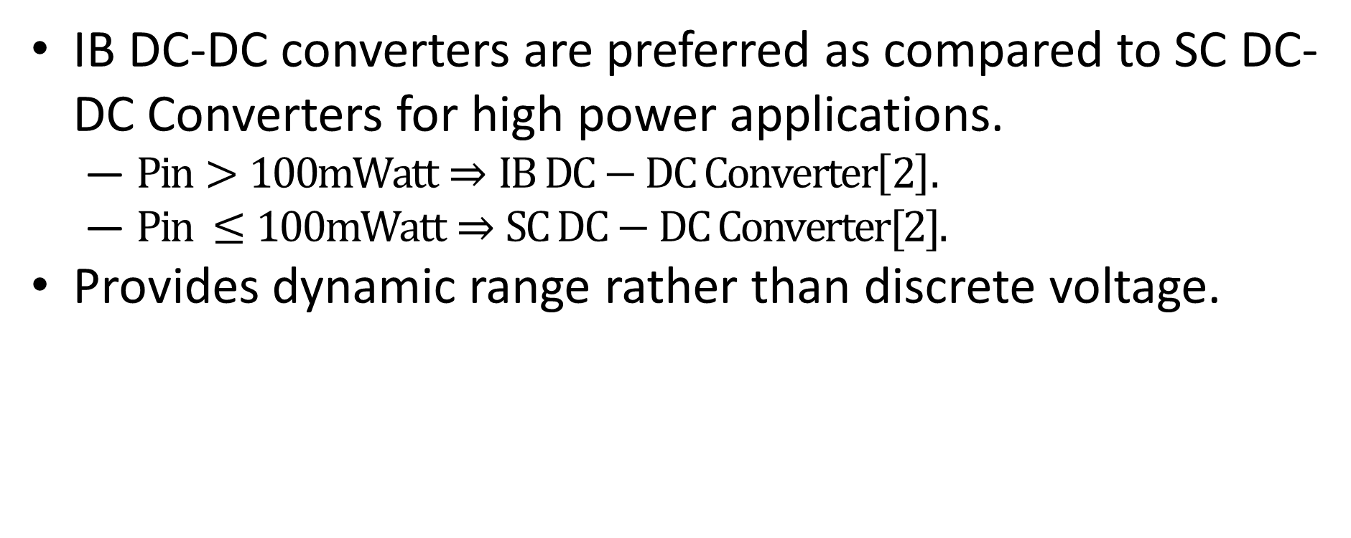
Why Inductor based DC-DC Converter?
IB DC-DC converters are preferred as compared to SC DC-DC Converters for high power applications.
$Pin>100mWatt⇒IB DC−DC Converter\left[2\right].$
$Pin ≤100mWatt⇒SC DC−DC Converter[2].$
Provides dynamic range rather than discrete voltage.
2. A comparative analysis of Switched-Capacitor and inductor-based DC-DC conversion technologies. In 2010 IEEE 12th Workshop on Control and Modeling for Power Electronics. IEEE.

Slide 7
Transient Response of Inductor Based Step Down Converter
Fast transient response plays vital role in high speed applications.
Sudden transient, due to the load variation, causes instability of the system.
Each converter has to be stabilized at specific frequency known as Crossover frequency (fc).
fc=≈1/5, 1/10 of fs.
4. A four-phase buck converter with capacitor-current-sensor calibration for load-transient-response optimization that reduces undershoot/overshoot and shortens settling time to near their theoretical limits. IEEE JSSC ,2017

Slide 8
WORKING PRINCIPLE
Step down converter operates in two conduction modes.
Continuous Conduction Mode (CCM).
Discontinuous Conduction Mode (DCM).
PHASE 1: Current flow of DC-DC Converter when switch S1 is on and S2 is off
PHASE 2: Current flow of DC-DC Converter when switch S1 is off and S2 is on

Slide 9
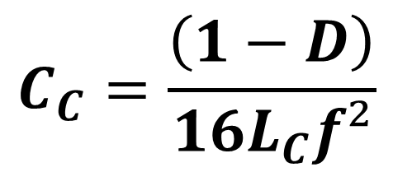
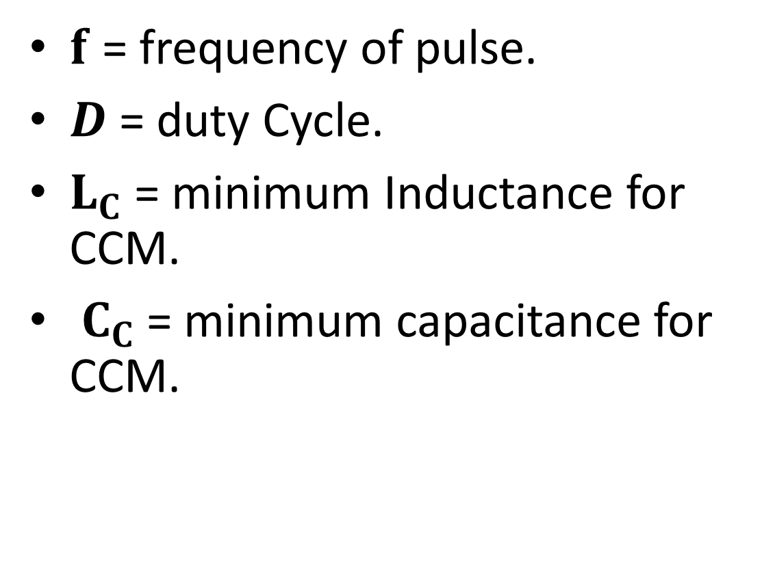
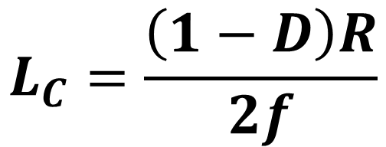
L AND C DEPENDENCE ON FREQUENCY
$f$ = frequency of pulse.
$D$ = duty Cycle.
$L_{C}$ = minimum Inductance for CCM.
$C_{C}$= minimum capacitance for CCM.
$$L_{C}=\frac{\left(1−D\right)R}{2f}$$
…(1)
$$C_{C}=\frac{\left(1−D\right)}{16L_{C}f²}$$
…(2)

Slide 10
BUILDING BLOCKS OF DC-DC CONVERTER

Slide 11
Problem Statement
Optimization of :
Transient response from no load to full load.
Delay of the control loop.

Slide 12
DELAY CONTRIBUTING ELEMENTS
Reason of poor Transient Performance
Switch Delay
L,C network Delay
Compensator Delay
Comparator Delay
Non Overlapping Clock Delay
Driver Delay

Slide 13
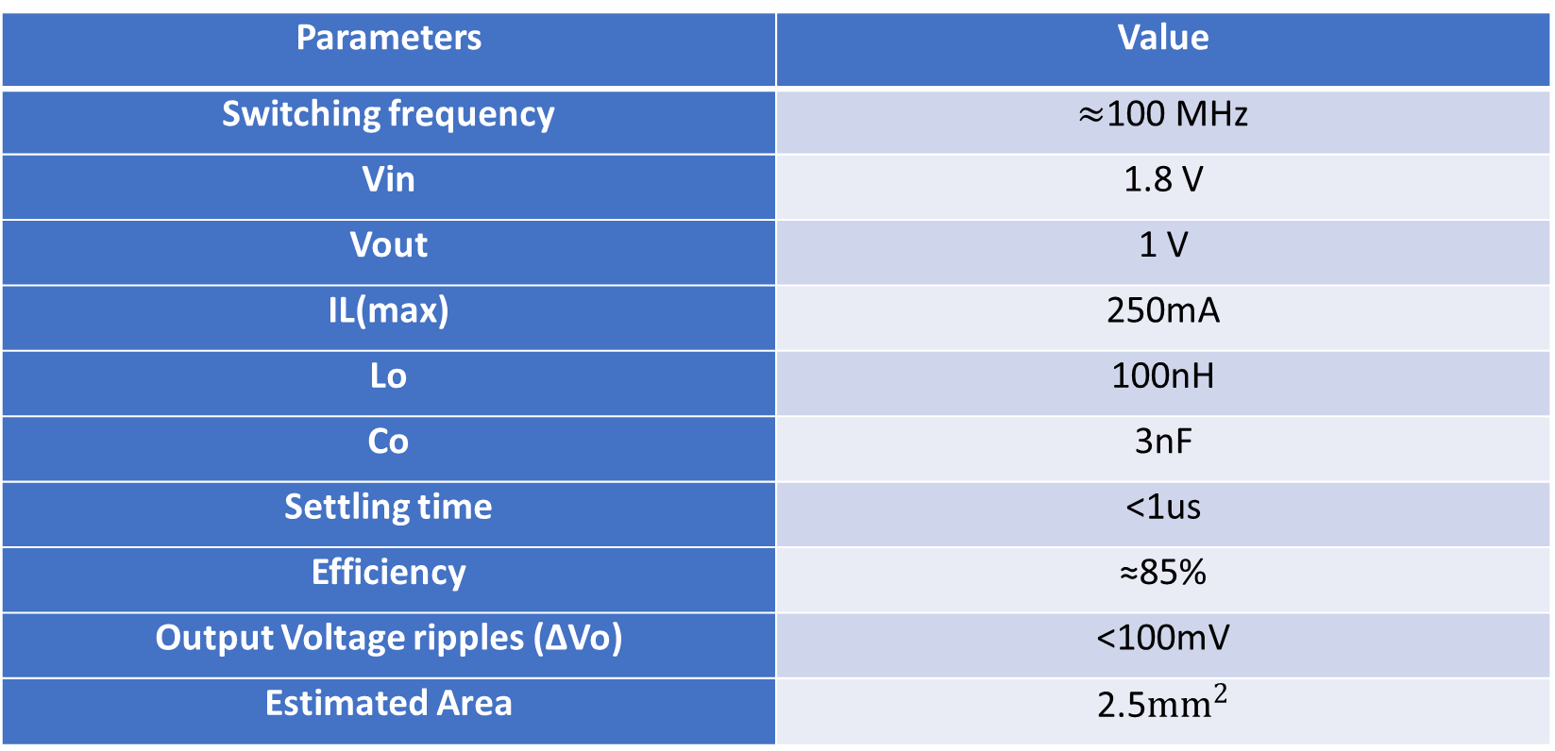
Design Goals
Parameters | Value
Switching frequency | $≈$100 MHz
Vin | 1.8 V
Vout | 1 V
IL(max) | 250mA
Lo | 100nH
Co | 3nF
Settling time | <1us
Efficiency | ≈85%
Output Voltage ripples (∆Vo) | <100mV
Estimated Area | 2.5${mm}^{2}$

Slide 14
Architecture

Slide 15
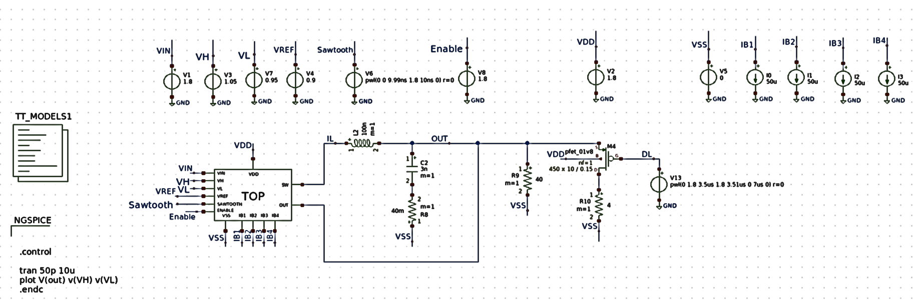
TOP View

Slide 16
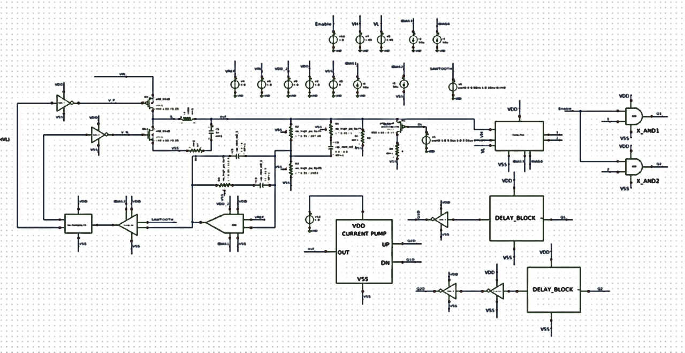
CLOSED LOOP DC-DC CONVERTER SCHEMATIC (SKYWATER 130NM)

Slide 17
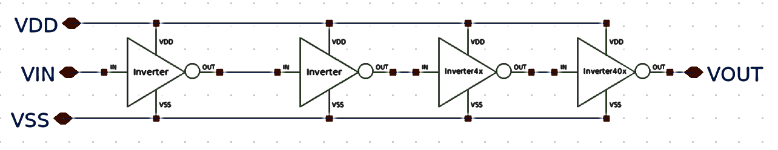
Buffer Schematic

Slide 18
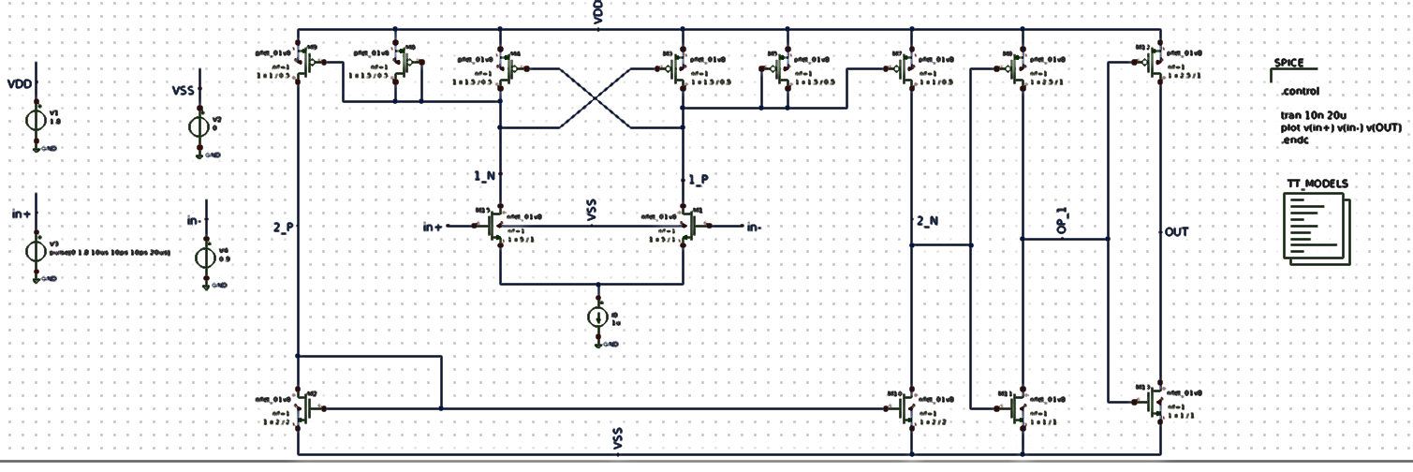
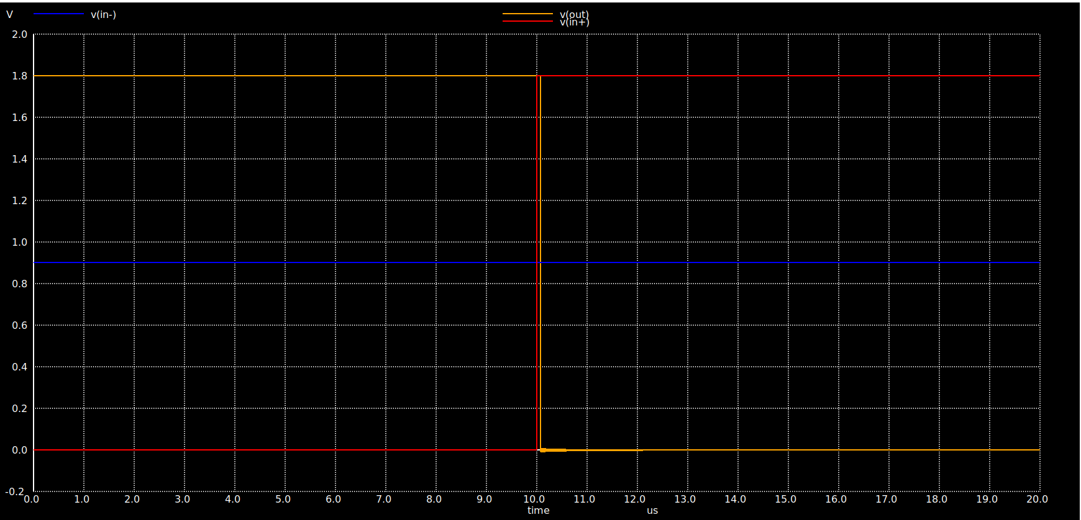
COMPARATOR

Slide 19
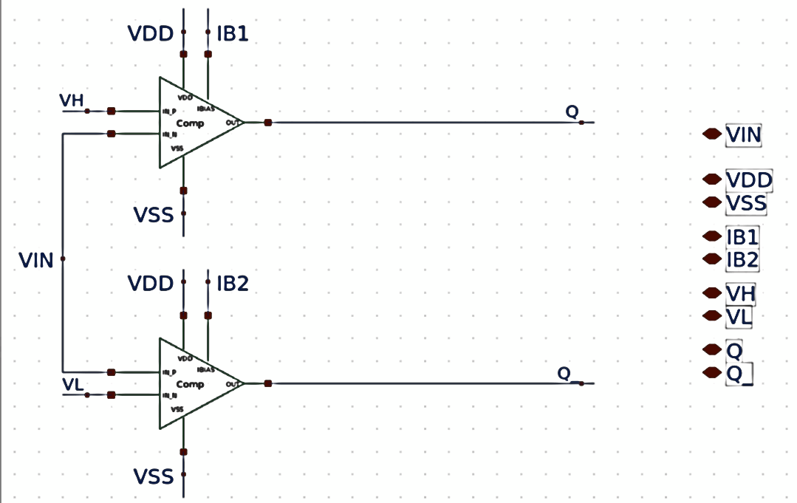
Comparator Pair

Slide 20
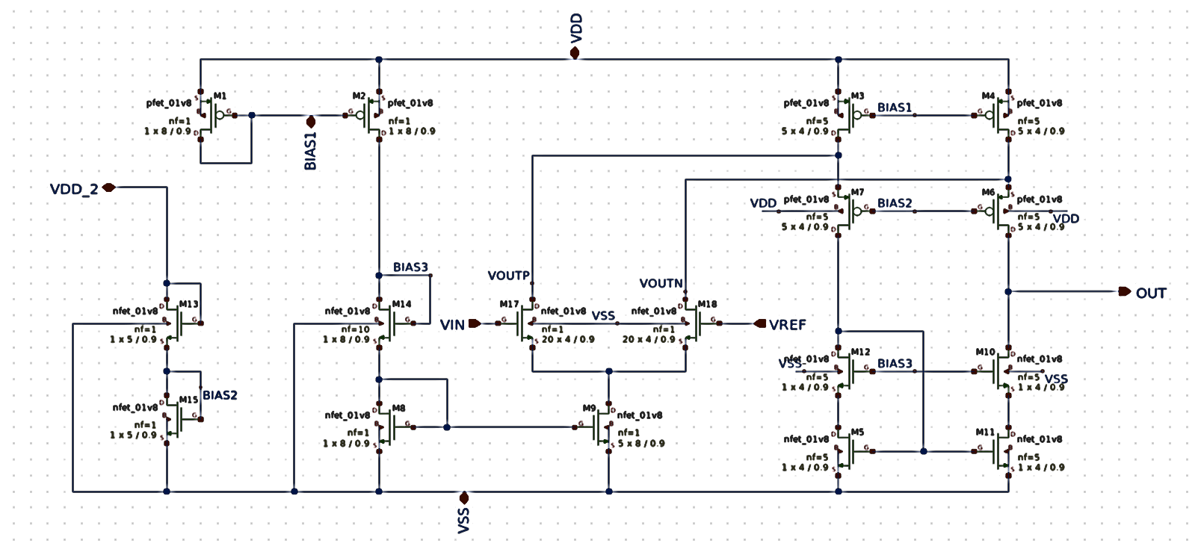
FOLDED CASCODE AMPLIFIER
DC Gain=49 dB
f3dB = 13 MHz
fUGB = 1.8 GHz
Phase Margin= 115 deg

Slide 21
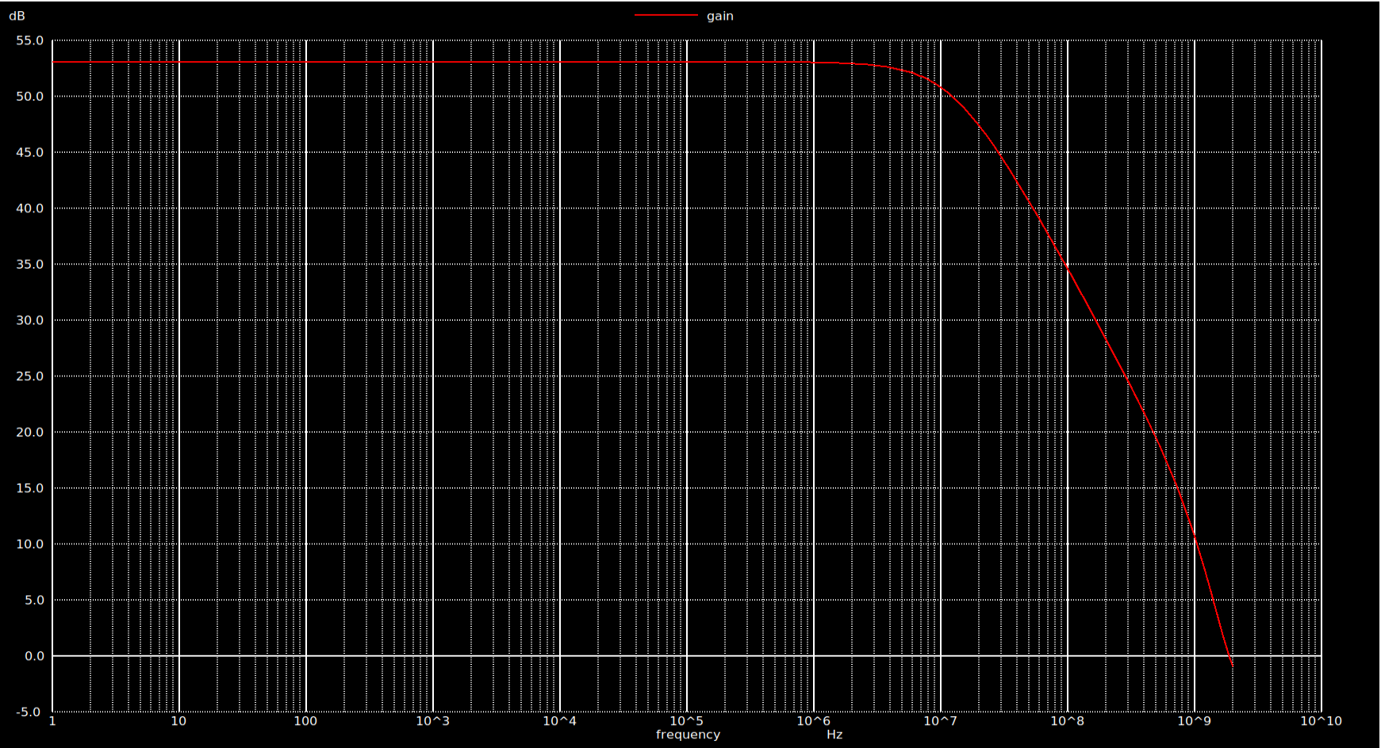
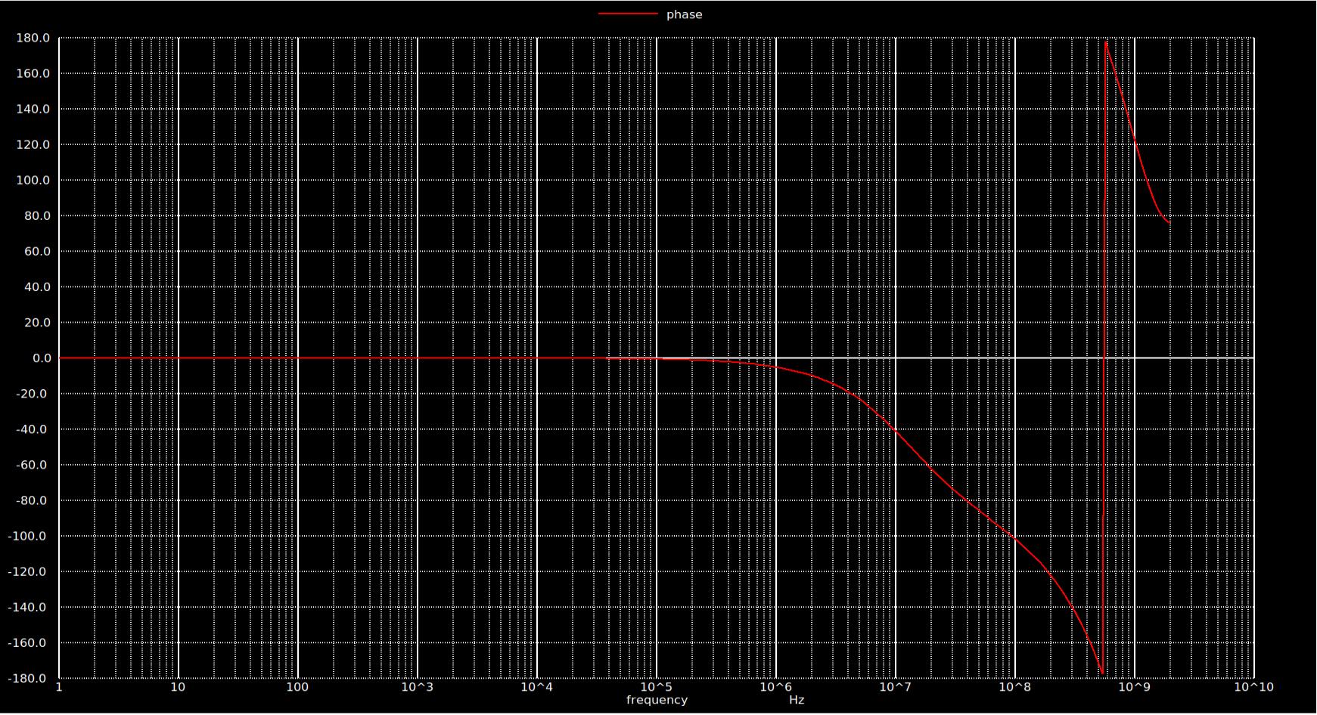
FOLDED CASCODE AMPLIFIER
Gain plot
Phase plot

Slide 22
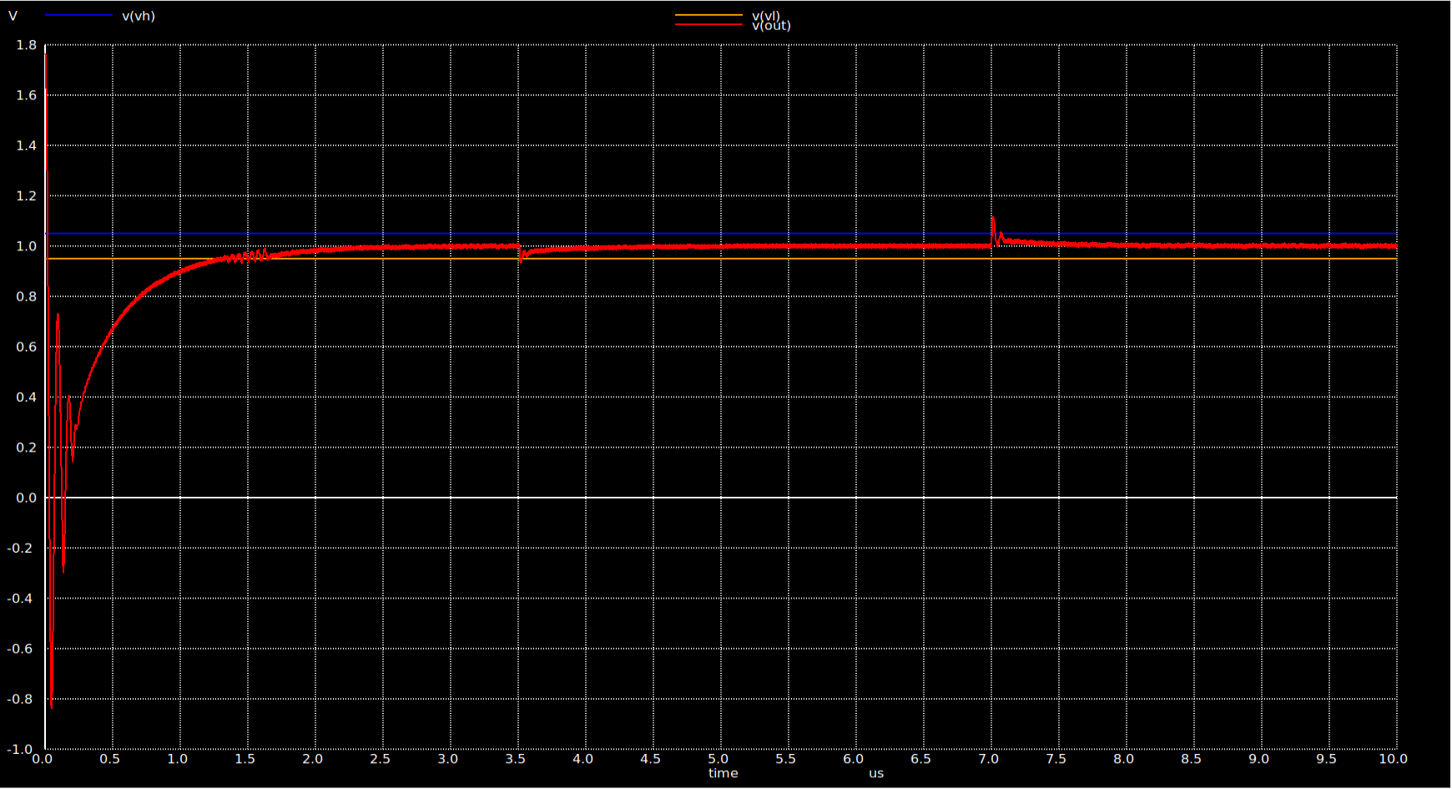
FINAL SIMULATION RESULTS (SKYWATER 130NM)

Slide 23
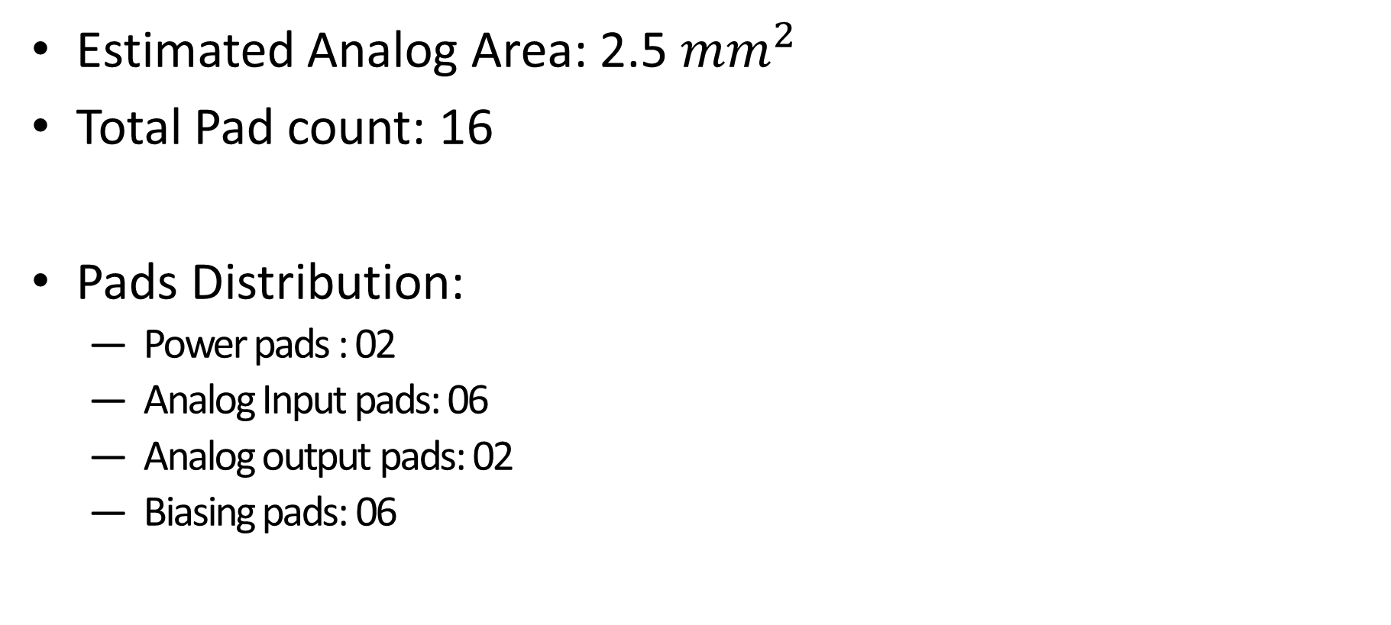
AREA ESTIMATE AND PAD COUNT
Estimated Analog Area: 2.5 ${mm}^{2}$
Total Pad count: 16
Pads Distribution:
Power pads : 02
Analog Input pads: 06
Analog output pads: 02
Biasing pads: 06

Slide 24
REFERENCES
Electrical and thermal characterization of an inductor-based ANPC-type buck converter in 14 nm CMOS technology for microprocessor applications. IEEE Open Journal of Power Electronics,2020.
A comparative analysis of Switched-Capacitor and inductor-based DC-DC conversion technologies. In 2010 IEEE 12th Workshop on Control and Modeling for Power Electronics. IEEE.
Investigation of On-Chip Inductors for Fully Integrated DC-DC Converters. arXiv preprint arXiv:1909.13622 ,2019.
A four-phase buck converter with capacitor-current-sensor calibration for load-transient-response optimization that reduces undershoot/overshoot and shortens settling time to near their theoretical limits. IEEE JSSC ,2017.
5. Design of a 20 MHz DC-DC buck converter with 84 percent efficiency for portable applications. In 2011 24th International Conference on VLSI Design, IEEE, 2011.
6. A SAR-ADC-Assisted DC-DC Buck Converter With Fast Transient Recovery. IEEE Transactions on Circuits and Systems II, 2020.

